Slide 1
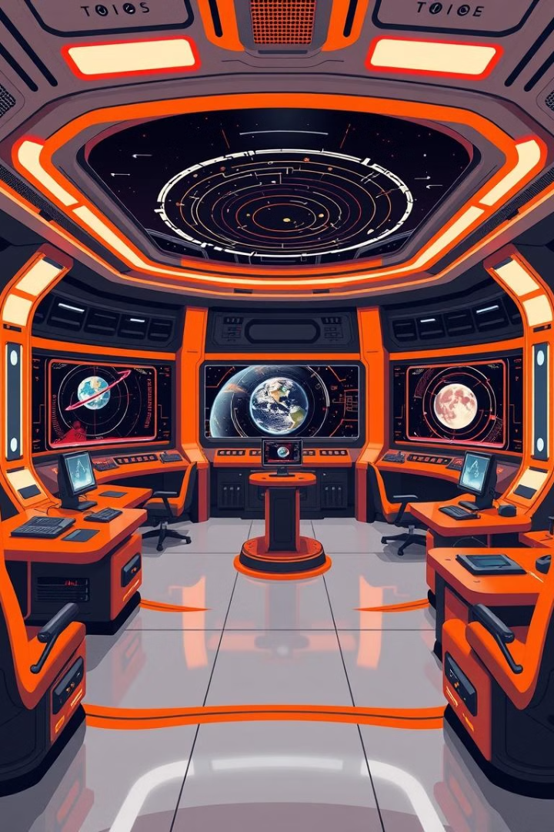
Creating an Orrery Web App for Near-Earth Objects
TEAM NAME : 32 BYTE
TEAM MEMBERS
Adhithi S
Jobinakrishnan N
Sona Reji
Nanditha K
Malavika K C
Aneeshya K Madhu

Slide 2
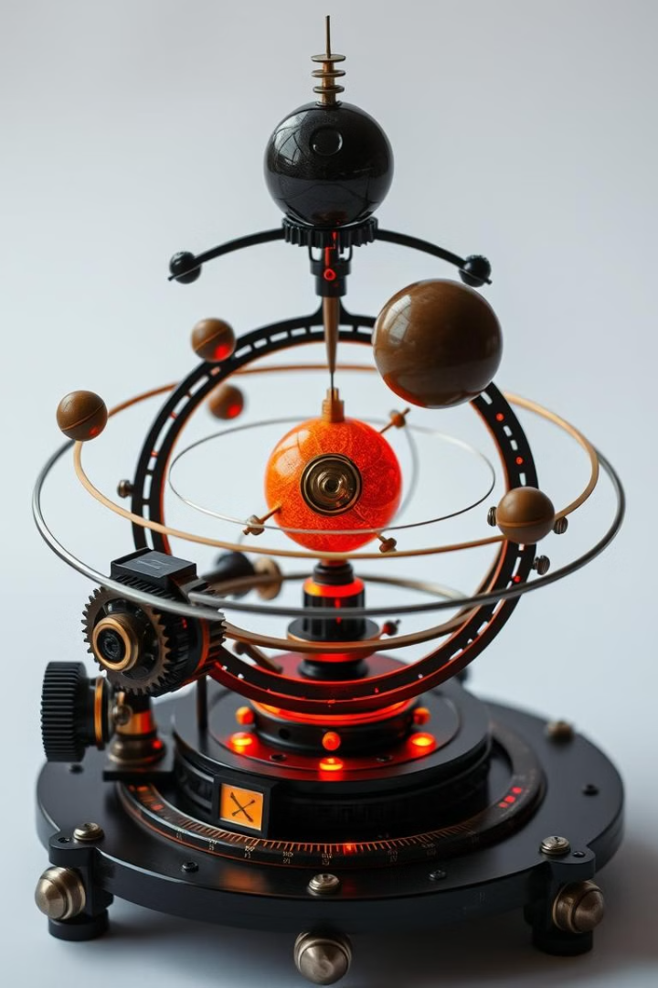
What is an Orrery?
An orrery is a mechanical device that models the relative positions and motions of the planets and moons in the Solar System. Our Orrery Web App aims to digitally recreate this experience, making it accessible to a wider audience online.

Slide 3

Importance of Tracking Near-Earth Objects
1
Planetary Defense
2
Scientific Research
Monitoring near-Earth objects is crucial for early detection and prevention of potential impacts that could cause devastating damage.
Studying the composition and orbits of near-Earth objects provides valuable insights into the formation and evolution of our solar system.
3
Public Awareness
Educating the public about the threats and opportunities presented by near-Earth objects is essential for fostering a deeper understanding of our celestial environment.

Slide 4
Key Features of the Orrery Web App
Real-Time Data
Interactive Visualizations
Educational Resources
Our app will integrate live data feeds from NASA and other leading sources to provide up-to-date information on near-Earth object positions and trajectories.
Users will be able to explore the orbits of planets and asteroids in a visually engaging 3D environment, with the ability to zoom, pan, and filter data.
The app will include informative articles, videos, and interactive simulations to educate users about the significance and science behind near-Earth object tracking.

Slide 5

Visualizing Orbital Dynamics
Gravitational Interactions
Elliptical Orbits
Our visualization will showcase the complex gravitational influences between near-Earth objects and the Sun, revealing their dynamic and ever-changing trajectories.
Accurately depicting the elliptical nature of planetary and asteroid orbits around the Sun is a key feature of our Orrery Web App.
1
2
3
Orbital Periods
The app will visualize the varying orbital periods of different near-Earth objects, allowing users to understand their unique patterns of movement.

Slide 6
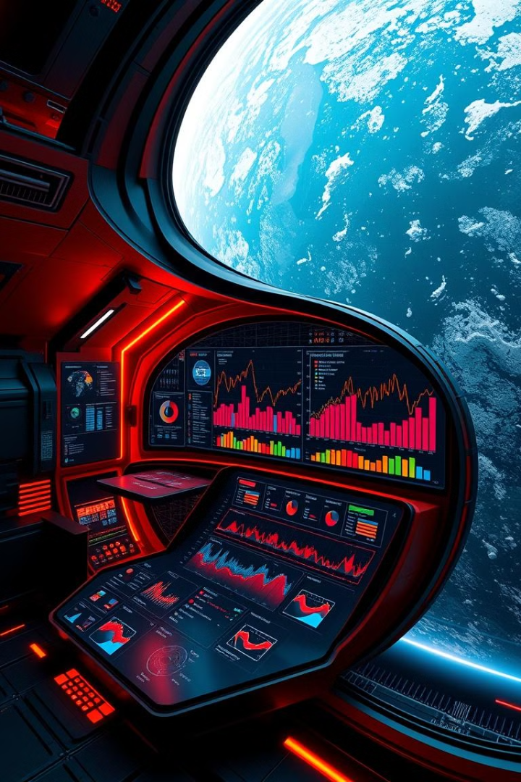
Integrating Live Data Feeds
NASA's NEO Database
Automated Data Ingestion
Our app will leverage the vast database of near-Earth object information maintained by NASA, ensuring users have access to the most up-to-date and authoritative data.
The Orrery Web App will feature a robust data pipeline that continuously ingests and processes real-time updates from multiple sources, keeping the visualizations dynamic and responsive.
Analytical Insights
By combining the live data with advanced analytics, our app will provide users with valuable insights and predictions about the movements and potential risks of near-Earth objects.

Slide 7




Deployment and User Experience
Cross-Platform
User-Friendly
Collaborative
The Orrery Web App will be designed to be fully responsive and accessible across a wide range of devices, from desktop computers to mobile phones.
Our focus on intuitive navigation and a clean, uncluttered interface will ensure a seamless and engaging user experience for both casual and expert users.
The app will provide sharing and collaboration features, allowing users to exchange insights, annotations, and findings with the broader scientific community.

Slide 8
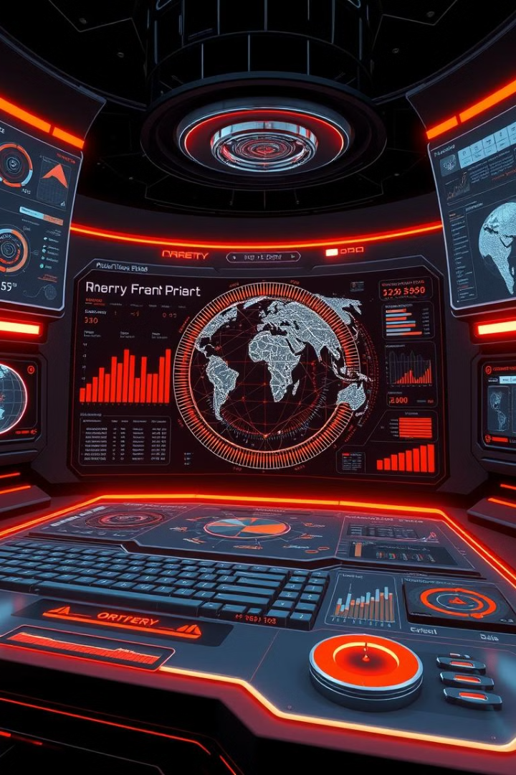



Future Enhancements and Possibilities
Augmented Reality
Integrating AR capabilities to allow users to visualize near-Earth objects in their physical environment, further enhancing the educational and immersive experience.
Advanced Simulations
Developing sophisticated simulations that model the complex gravitational interactions and potential impact scenarios of near-Earth objects, enabling scenario planning and risk assessment.
Predictive Analytics
Leveraging machine learning and AI to provide accurate predictions of near-Earth object trajectories and potential threats, supporting strategic decision-making and early warning systems.

